Slide 1
Battle of Neighborhoods
Author - Abhinav Paul
Created - 30 April ‘20

Slide 2
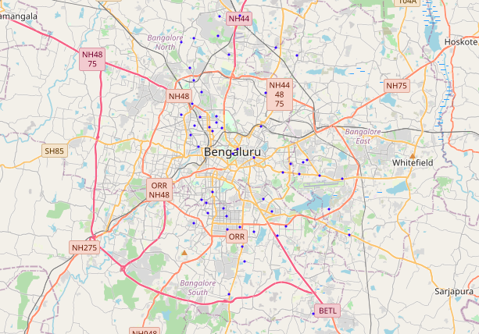
Content
Introduction - Problem Statement
Data - sources and Preparation Methods
Methods of Clustering
Analysis - Findings and Insight
Assumptions
Conclusion

Slide 3
Problem Statement
Current State
Bangalore city is too big for immigrant workforce to explore in a targeted way and know which area hold establishments offering activities and services to their liking, so that they can feel at home away from home just by exploring that place sooner.
There is a need of an exploratory page that can provide information on similar Localities. The similarity can be based on the types of venue categories which are most frequently available in a given Neighborhood of Bangalore.
Desired Output
This notebook will be used to explore Bangalore for answering the question of what kind of venues are mainly available in any given Locality of the City and cluster similar Neighborhoods.

Slide 4
Data - Sources and Preparation methods
Postal Code Raw Data* - https://data.gov.in/catalog/all-india-pincode-directory
Content - Pincode, Suboffice name, Taluka , District, State and other official data
Pre-Processing - Filtered data to keep District 'Bangalore' and to keep following columns. Re-labelled them for better understanding
pincode : PostalCode
officename : Neighborhood
Districtname : City
Latitude
Longitude
Venue Data - Foursqaure API** : https://api.foursquare.com/v2/venues/explore
Content - Venue, Venue latitude, Venue longitude, Neighborhood Name, Neighborhood latitude, Neighborhood longitude
Pre-processing - Data was extracted and renamed as per week 3 assignment. Used the function "getNearbyVenues" to get the details from data returned on Venue endpoint call from Foursquare API
* Limitation - Due to lack of Latitude and Longitude information available in the government site, all localities of Bangalore district are not explored.
**Limitation - This data contains limited information based on user checkins at a given location in the database. For more information on the spread and depth of data, please refer to - Link.

Slide 5
Clustering process
Step 1 - Identifying the top 5 most frequent venue category for a neighbourhood
Step 2 - Clustering neighbourhoods based on the top 5 venues for similar Neighbourhood
Step 3 - Mapping out the Cluster in the Map and marking them with a color code
Jupyter Notebook Link - https://github.com/abhi-2693/Coursera_capstone/blob/master/Capstone%20project/CapstoneProj_BattleoftheNeighborhoods.ipynb
Note : All steps are similar to week 3 Assignment of Toronto Neighbourhood Exploration

Slide 6
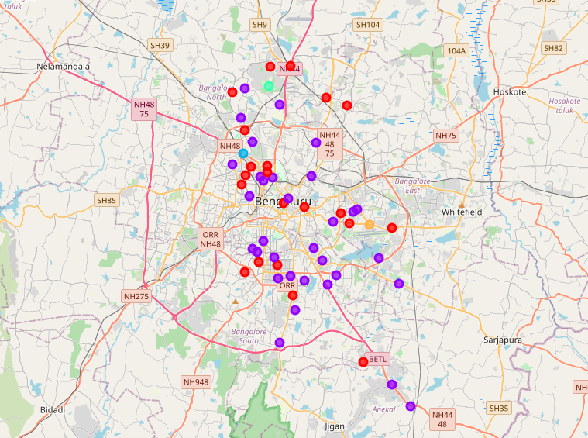
Clustering output
Cluster 1 - Markered Violet . .
Contains mainly of venues in the categories of Cafe’ and Pubs
Cluster 2 - Marked Red . .
Contains mainly of venues in the categories of Indian and Fast food Restaurants
Cluster 3 - Marked Light Blue . .
Contains Train Station
Cluster 4 - Marked Light green . .
Contains Gardens and Basketball courts
Cluster 5 - Marked Orange . .
Contains Bus stops and Farmer Markets

Slide 7
Analysis Summary
From the data we can make that Bangalore has main two categories of venue clusters of Restaurants and Cafe/Pubs spread across city
The main train station in the city is at Cluster 3 - Yeswantpura S.O
The main place for buses is at cluster 5 - Vimanapura S.O
The main locality for recreational activity are mainly at cluster 4 - G.K.V.K. S.O

Slide 8
Assumption
Venue data like names and Categories available is considered to be exhaustive for the city
Top 5 frequent venues can help us identify the type of the locality we have in hand for exploration

Slide 9
Conclusion
Being a resident of Bangalore I can say the clusters available is largely correct with the data available. This page will get more robust with addition of venue data available in Foursqaure API.
This page can be used as a starting for the Immigrants to Bangalore to go and see the places to visit as per need.

